Slide 1
REST Best Practices
Claxton Correya
Dev@CBA

Slide 2
Agenda (or Why bother with this talk?)
Standards, guidelines and the rest of the noise
How to deal with the problems that Dev’s & QA’s face
E.g. Versioning, Caching, Validation, Tracing
Alternates like GraphQL
Answer any questions

Slide 3
Why business requirements over standards?
Unfortunately we have deadlines
Security, Caching, Independence, Scalable etc. are hard
Some guidelines are hard or might not work for us
Specifically HTTP + JSON
HATEOAS (Hypermedia As The Engine Of Application State)
Make SSL mandatory

Slide 4
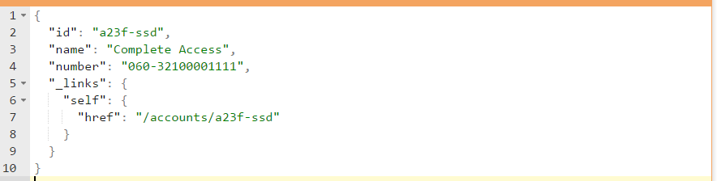
Examples
GET /accounts/a23f-ssd
But what if the response was an image?

Slide 5
How to deal with …?

Slide 6
Request & Response
Verbs – GET PUT POST DELETE HEAD PATCH CONNECT OPTIONS
Not really CRUD
Headers – Accept, Content, Cache
Status Codes
Success: 200 201 202 204
Redirection: 301 302
Client Error: 400 401 403 404 409 413 415
Server Error: 500 503
What about Facebook 200 OK with response body having error details?

Slide 7
Request & Response
Nouns not Verbs
Collections and instances
CONTENT Header & ACCEPT Header
Accept application/json, text/plain
Filter, Sort and Pagination

Slide 8
Versioning
Headers vs URL vs Query String
Treat version as feature toggle (branching by abstraction)
Start with single deployment for multiple versions
Separate deployments for separate versions (SLA based)
GIT: master branch vs separate version branches vs separate forks
Semantic versioning of APIs

Slide 9
Tracing
Start with sending back a Correlation-Id
Honour any Correlation-Id
Pass this to calling systems (APIs, DBs etc)
Read about Dapper (Distributed Tracing Google White Paper)

Slide 10
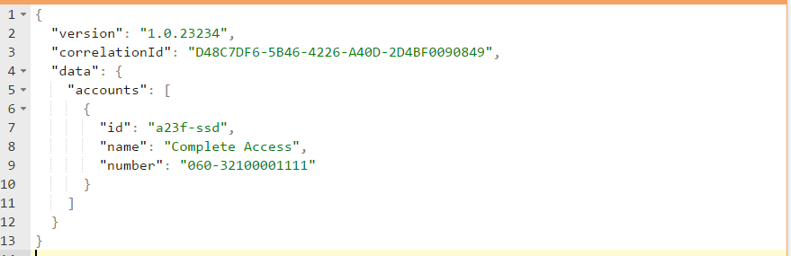
Examples
GET /accounts/a23f-ssd

Slide 11
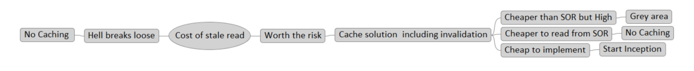
Caching
Complex problem to solve
Set to no-cache to start of with
This takes out any unknown behaviour from day one
ETag & Last Modified

Slide 12
Different views of the same Resource
GET /accounts/060-32100001111/views/balance
GET /accounts/060-32100001111/views/tplus1
GET /accounts/060-32100001111?view=balance&expand=agent
GET /accounts?view=agentdetails
GET /views/accounts/realtimebalance
GET /views/accounts/agentdetails
PREFER header (ODATA - Open Data Procotol)

Slide 13
Validation, Errors & Warnings
Validating a request before submitting
Structure to the response
Many servers in between
4XX or 5XX with a known structure makes it easier to differntiate
Link to documentation if possible
Auto mappers & Fluent Validators – Good or Bad?
Read about Problem Details for HTTP APIs (application/problem+json)

Slide 14
Examples
POST /accounts/actions/validate
200 OK
400 Bad Request
POST /validators/accounts
200 OK
400 Bad Request
POST /accounts followed by POST /accounts/a23f-ssd/states
2xx (internally stored as initiated and then created)
4xx

Slide 15
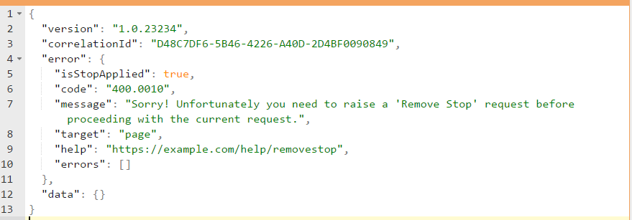
Examples
PUT /accounts/a23f-ssd
400 Bad Request

Slide 16
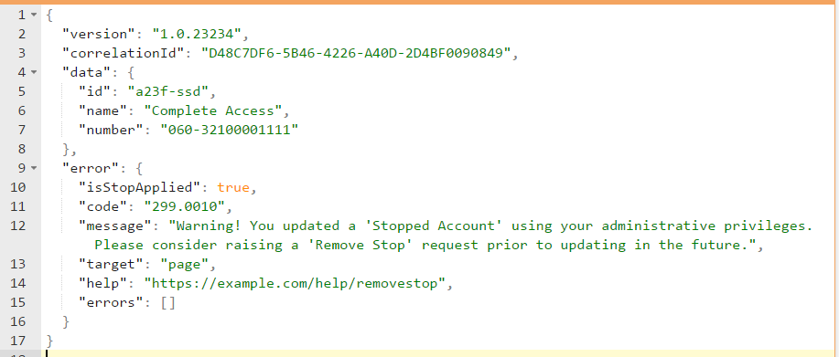
Examples
PUT /accounts/a23f-ssd
200 OK

Slide 17
Maintenance & Deprecation
APIs have a life cycle
Months to Years
Give clients option to test and stub
Have contract tests to honour client calls
Read about PACT
Start with a readme file
Swagger vs RAML vs API Blueprint vs …

Slide 18
Security
Basic Authentication
OAuth
SASL
Certificates

Slide 19
Rate Limitation
Rate limiter throttling
Rate limiter response headers
X-Rate-Limit vs X-RateLimit
Handle Limit
Handle Remaining
Handle Reset

Slide 20
Alternates & Future
GraphQL
REST for IoT devices

Slide 21
Summary
Why pragmatism helps
Respecting Dev’s & QA’s
Opinionated: How to deal with common situations
Future of REST APIs

Slide 22
Questions?

